Slide 1

Sentiment tagging & keyword extraction of hotel reviews
Pengyu Chen (pengyu2), Songwei Feng (songwei3), Xinrui Ying (xinrui2)

Slide 2
Outline
Introduction
Usage of the software
Examples

Slide 3
Introduction

Slide 4
Motivation
Given a hotel review, whether it is a positive one or a negative one?
Sentiment Polarity Tagging
Can we find out any useful information from it?
Keyword Extraction

Slide 5
Download
URL
https://github.com/rosafsw/CS410Project
Files You’ll Need
review_examples.txt: contains texts of the examples shown later
review_analyzer.py: the main program

Slide 6
Usage of the software

Slide 7
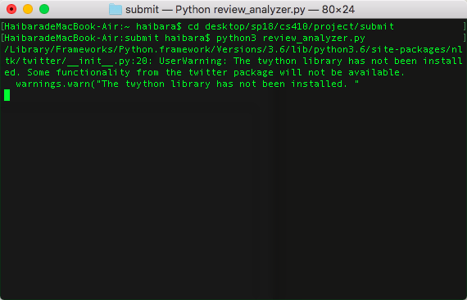
Run the Program
1. Launch Terminal and navigate to the folder where the program is located
2. Call “python3 review_analyzer.py”
Note: packages NLTK, rake_nltk, and PyQt5 are reuiqred

Slide 8
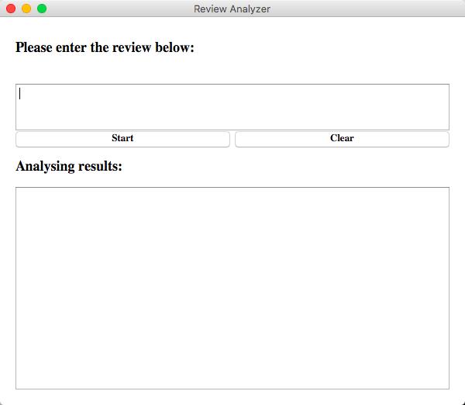
User Interface
A window pops up in a few seconds
To run it, paste a review into the text box and click “Start”
To start a new analysis, click “Clear”, paste the new text into the box, and click “Start” again
Note: The first run could take up to a few minutes depending on your machine

Slide 9
Examples

Slide 10
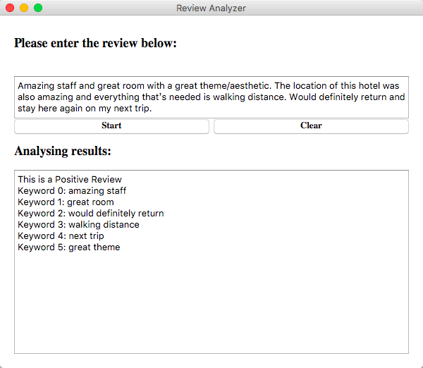
Example 1
Input Text (5 Star)
Amazing staff and great room with a great theme/aesthetic. The location of this hotel was also amazing and everything that’s needed is walking distance. Would definitely return and stay here again on my next trip.

Slide 11
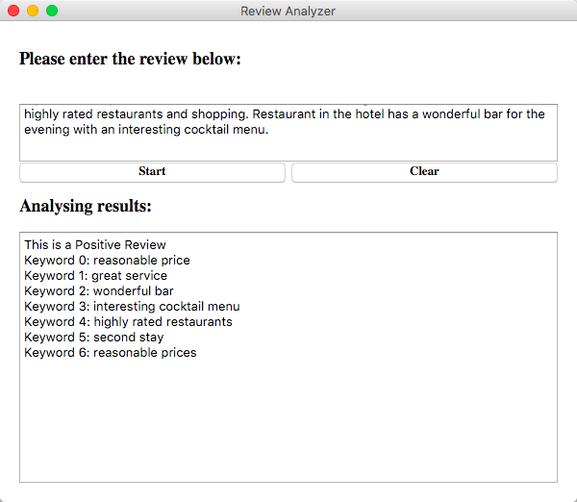
Example 2
Input Text (5 Star):
My second stay at this hotel. It has reasonable prices and great service and is close to highly rated restaurants and shopping. Restaurant in the hotel has a wonderful bar for the evening with an interesting cocktail menu.

Slide 12
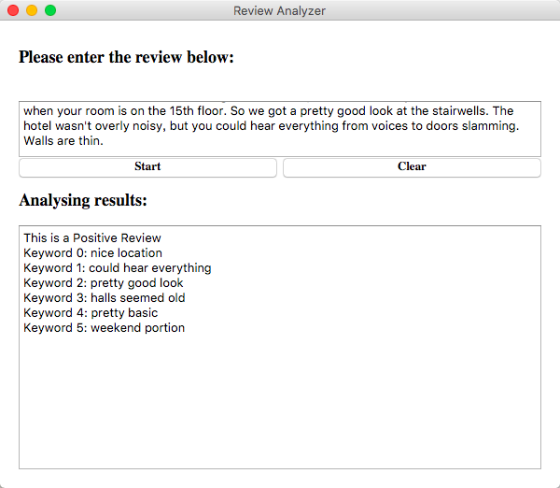
Example 3
Input Text (3 Star):
Picked the Talbott because it had just been renovated and it's in nice location. The rooms were fine, pretty basic, nothing extraordinary. It seemed that the rest of the hotel didn't get the same makeover as the rooms - carpets in halls seemed old, walls were scuffed. One of two elevators was out during the weekend portion of our stay. Not convenient when your room is on the 15th floor. So we got a pretty good look at the stairwells. The hotel wasn't overly noisy, but you could hear everything from voices to doors slamming. Walls are thin.

Slide 13
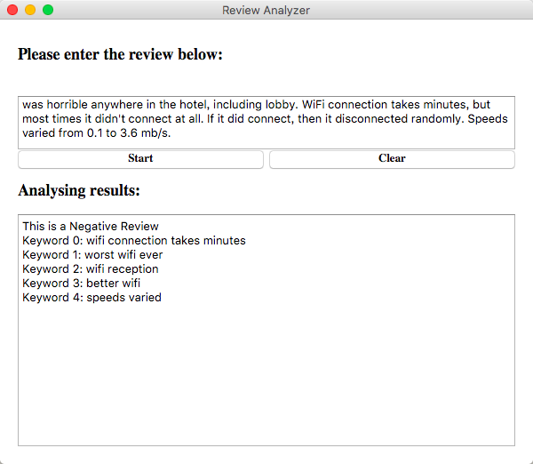
Example 4
Input Text (1 Star):
Worst WiFi EVER, i have had better WiFi in the middle of the everglades! WiFi reception was horrible anywhere in the hotel, including lobby. WiFi connection takes minutes, but most times it didn't connect at all. If it did connect, then it disconnected randomly. Speeds varied from 0.1 to 3.6 mb/s.

Slide 14
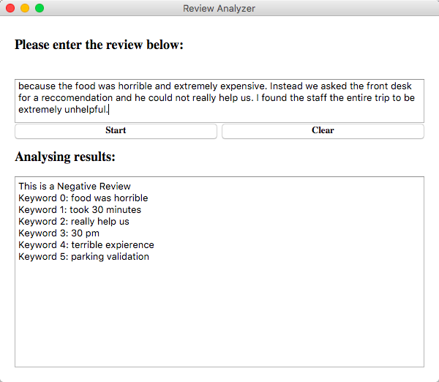
Example 5
Input Text (1 Star):
I had a terrible expierence at this hotel. We arrived at 9:30 pm and it took 30 minutes for us to check into the hotel. There were 2 guests in front of us and one was waiting for parking validation. The staff was incredibly slow. We wanted to go to dinner at the hotel, but the empty restaurant had an hour wait at 10 pm. We learned in the end was a blessing because the food was horrible and extremely expensive. Instead we asked the front desk for a reccomendation and he could not really help us. I found the staff the entire trip to be extremely unhelpful.

Slide 15
Thanks for watching

